Slide 1


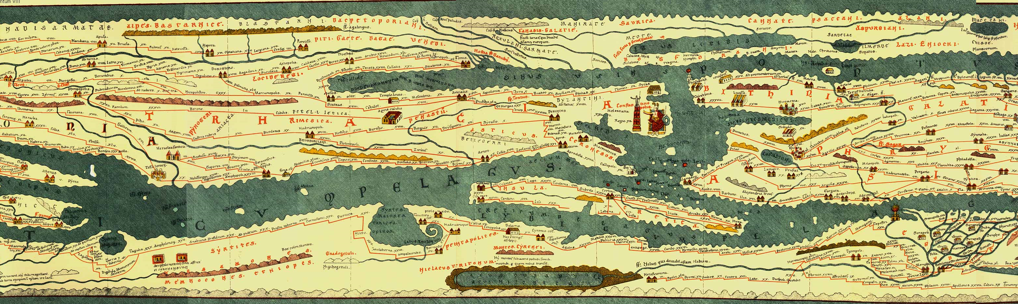
With the support of the Erasmus+ programme of the European Union. This document and its contents reflects the views only of the authors, and the Commission cannot be held responsible for any use which may be made of the information contained therein.
The cultural economy: how to enhance cultural heritage in a new sustainable economy

Slide 2
Objectives and goals
At the end of this module you will be able to:
Understand how cultural heritage boosts regional and local economies
Identify strategies to promote cultural heritage and make it sustainable

Slide 3


Intro: importance of CH
EU authorities consider culture and cultural heritage as high priority policies
Important for European citizens: Dec 2017 Eurobarometer survey shows that more than 80% European citizens thought that it was important both personally and for the EU

Slide 4





Cultural heritage is a multidimensional concept
But it is also an economic resource that helps to promote economic growth
  Production=labour+capital (natural, physical, human, cultural)

Slide 5
Cultural capital is a particular economic asset:
  Is a non excludable good (everybody can potentially consume it)
  Is a non rival good (you can consume without diminishing the consumption of other users)
These characteristics make cultural heritage a way of attracting tourism, not necessarily based on 3S formula (sand+sun+sea)

Slide 6
How cultural heritage helps to promote tourism?
Roman routes are here
Tangible heritage is defined as “..physical artifacts that are produced, maintained and transmitted from generation to generation in society”
Source: World Tourism Organization (2018), Tourism and Culture Synergies

Slide 7
By how much cultural heritage tourism contribute to economic growth?
Important source of income and employment for economies
Countries with large cultural heritage assets are the most benefited
Opportunities for countries that did not exploit much this asset
Source: World Tourism Organization (2018), Tourism and Culture Synergies

Slide 8
By how much cultural heritage tourism contribute to economic growth? (in the EU)
Source: European Commission (2017), Spotlight on the European Year of Cultural Heritage 2018

Slide 9
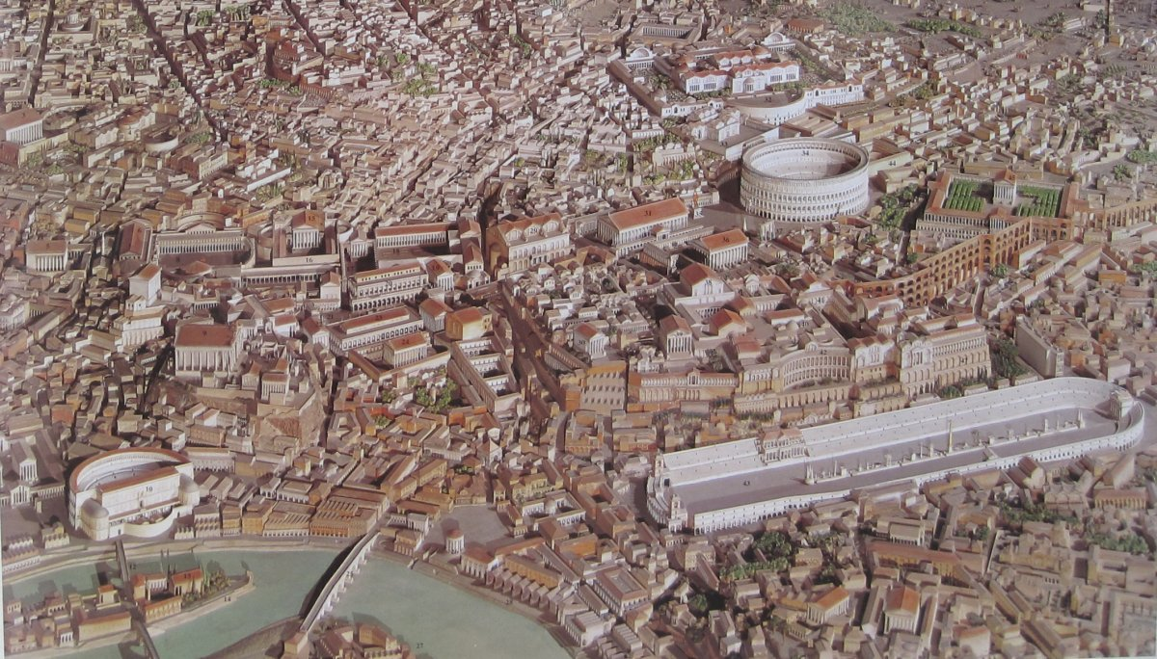
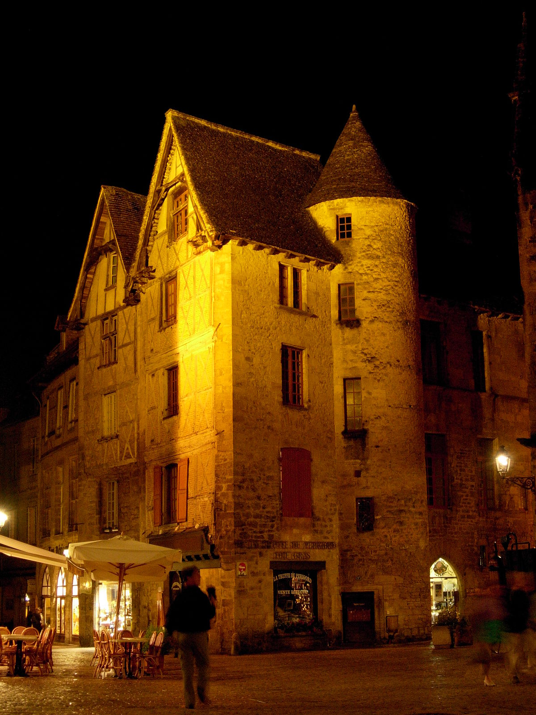
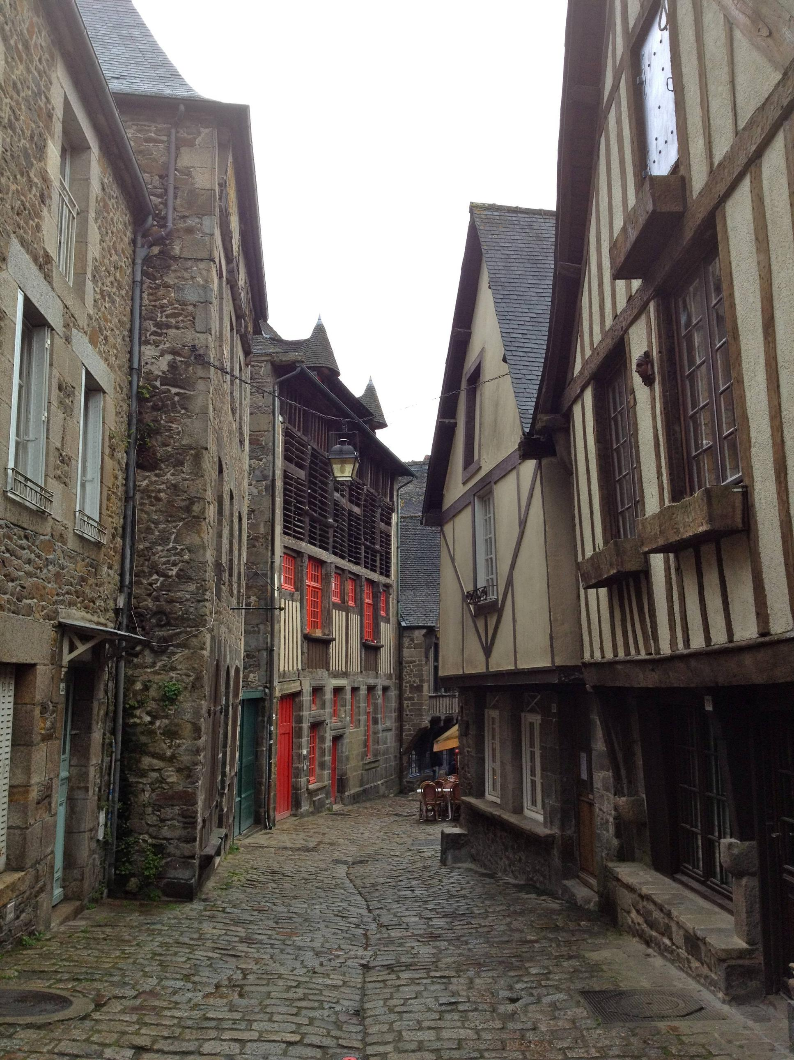
Cultural Heritage and sustainable economic growth
  Preservation of CH can be seen as a barrier to economic development, but a large body of research has shown the positive relation between CH preservation and economic development: not only tourism but revitalization of historical city centers

Slide 10
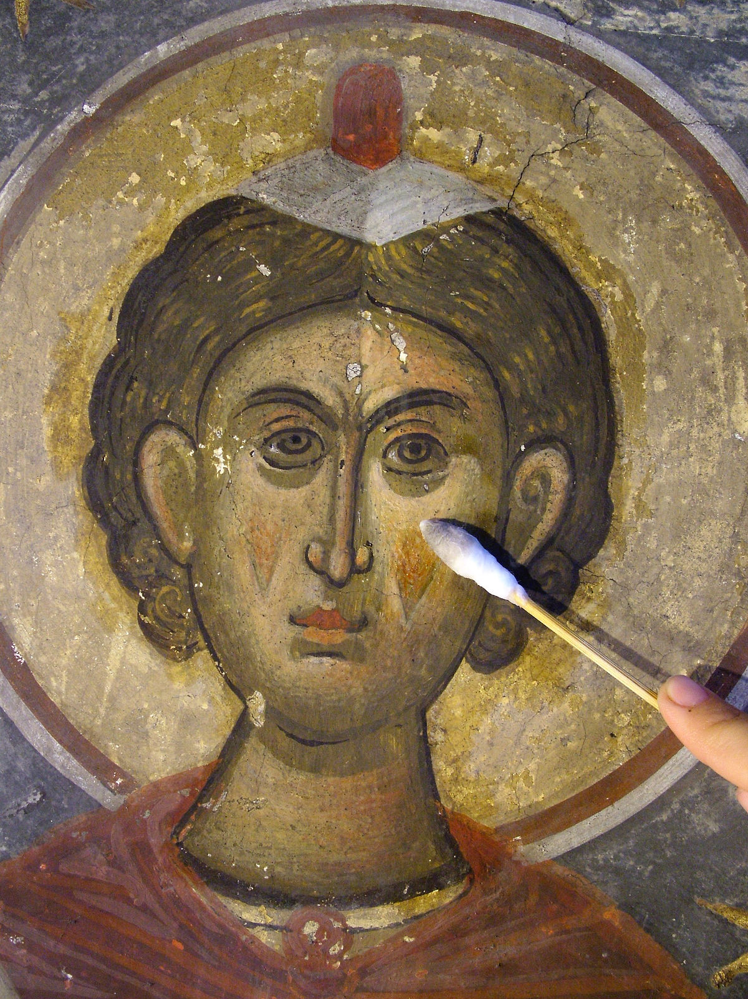
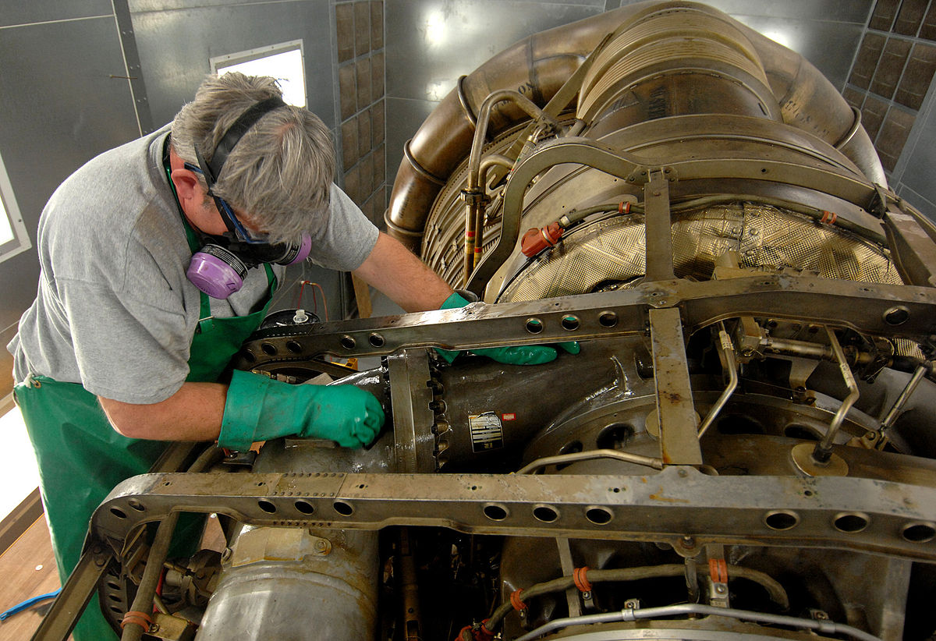
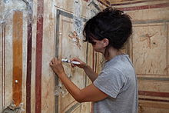
Cultural Heritage and sustainable economic growth
  CH-related activities should be sustainable as well: Sustainability of CH implies assessing conservation and restoration investment projects

Slide 11
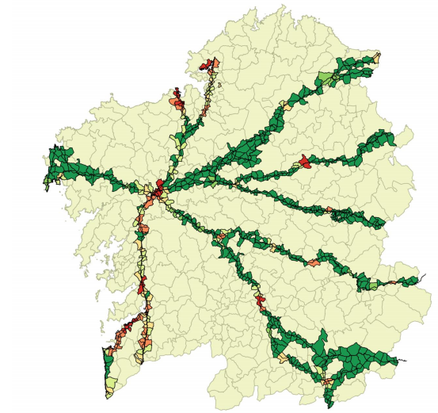
An example: Way of St. James (Camino de Santiago) in Galicia (Spain)
Significant contribution to the regional tourism figures: €1 consumed by the pilgrims generated €2.72 of value added
The demographic decline of rural areas is attenuated in those points through which the route passes
Local population considers that the Camino de Santiago contributes to preserving the landscape
Source: The socio-economic impact of the Way of St. James. USC and Regional Goverment of Galicia (2018)

Slide 12
Entrepreneur activities can benefit from the cultural tourism attracted by the presence of cultural heritage
Entrepreneurship depend on multiple factors:
  Access to finance
  Investment in technology and R&D
  Positive environment (entrepreneurship culture and regulatory framework)
  Cultural heritage entrepreneurship requires the presence of this resource in the territory

Slide 13
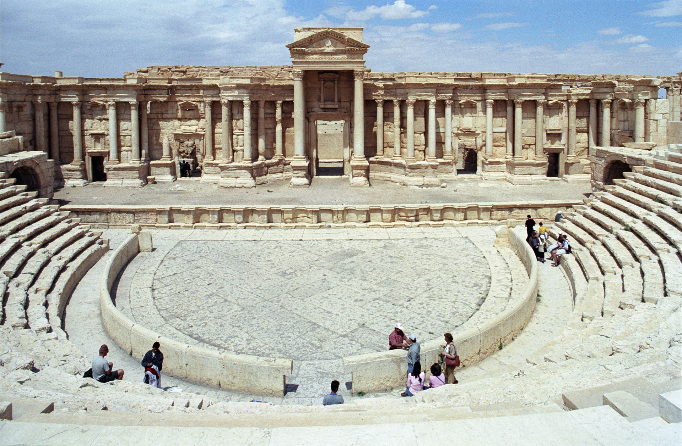

How to enhance cultural heritage?
Stocks of tangible (and intangible) CH assets are given, we cannot expand it

Slide 14

How to enhance cultural heritage?
Stocks of tangible (and intangible) CH assets are given, we cannot expand it… Or can we?

Slide 15
How to expand cultural heritage:
Stocks of tangible (and intangible) assets are given, we cannot expand it… Or can we?
Public authorities can enhance CH-related economic activities by :
  Preserving and restoring the existent CH assets
  Making it more accessible (both physically and digitally) for new potential customers

Slide 16
How to expand cultural heritage:
Stocks of tangible (and intangible) assets are given, we cannot expand it… Or can we?
Entrepreneur activities can enhance the business opportunities from cultural heritage by making it more:
  Visible to potential visitors through effective publicity campaigns
  Profitable by generating and specializing on high value-added related activities

Slide 17
Thank you for your attention !
With the support of the Erasmus+ programme of the European Union. This document and its contents reflects the views only of the authors, and the Commission cannot be held responsible for any use which may be made of the information contained therein.

