Slide 1
With the support of the Erasmus+ programme of the European Union. This document and its contents reflects the views only of the authors, and the Commission cannot be held responsible for any use which may be made of the information contained therein.
Tools to Describe and Validate Business Idea
(Entrepreneurship Section)

Slide 2
Objectives and Goals
At the end of this module you will be able to:
Effectively communicate your business (idea, aim, products, services)
Write a strong High Concept Pitch for your business
Validate your idea through experiments
Discover your customer: know her/him best, reach her/him easily
Lean Start-ups

Slide 3
Contents of the module
Unit 1: Pitch your start-up!
How to Pitch?
Why HCP is so Critical?
How to Build an effective HCP
Unit 2: The Javelin Board
Purpose and functioning
Left Side: Brainstorming Area
Right Side: Executive area
Underside: Get out of the Building

Slide 4
Unit 1: Pitch Your Start-up!
1.1 How to Pitch?
A pitch is a speech or an act that attempt to persuade someone of:
the validity of an idea
or a quality of a product/service
In order to make her or him inclined to:
invest in a business,
collaborate with the firm,
buy a product or a service.

Slide 5
Unit 1: Pitch Your Start-up!
1.1 How to Pitch?
!!! Different situation need different kind of Pitches !!!!
In your communication luggage you must always have got at least three different plans:
Elevator Pitch,
Two/Three sentence Pitch,
High Concept Pitch.

Slide 6
Unit 1: Pitch Your Start-up!
1.1 How to Pitch?
Elevator Pitch
A pitch you can dispatch in the time you are taking an elevator together with your potential client/investor.
A speech, a snapshot, a video that explains:
who you are / what your product (or service) is
the aim of your business / what your product does
why you are (or your product / service is) different
how your work / your product (or service) will get done

Slide 7
Unit 1: Pitch Your Start-up!
1.1 How to Pitch?
Two/three sentence Pitch - a
A pitch that looks like a spontaneous answer,
but that truly is FAR TO BE SO.
!!! To be effective you must be prepared !!!

Slide 8
Unit 1: Pitch Your Start-up!
1.1 How to Pitch?
Two/three sentence Pitch - b
First sentence
Explain what you do: a full, yet brief, summary of what your company does or provide
Second sentence
You must set what you want to achieve and why YOU, YOUR PRODUCTS or SERVICES are different - and better - of your competitors.

Slide 9
Unit 1: Pitch Your Start-up!
1.1 How to Pitch?
Two/three sentence Pitch - c
!!! Try to be as specific as possible in the second sentence !!!
You want the other person to remember you and (if you do it right)
make the wonder if they need what you do!

Slide 10
Unit 1: Pitch Your Start-up!
1.1 How to Pitch?
Two/three sentence Pitch - d
Third sentence - alias ZERO sentence
If you think you have time, you can start with a HOOK sentence.
The HOOK provides your audience with information that can create mental association with.
!!! the listener must be able to instantly process your hook, otherwise
s/he will not listen your following (and most valuable) sentences !!!

Slide 11
Unit 1: Pitch Your Start-up!
1.1 How to Pitch?
Two/three sentence Pitch - e
A last tip:
Your Two/Three sentence pitch can be the perfect intro
for your Elevator Pitch!

Slide 12
Unit 1: Pitch Your Start-up!
1.1 How to Pitch?
High Concept Pitch (HCP): a definition
HCP is the perfect tool for consumers and fans who are spreading the word about your company.
It is a single sentence distilling your company’s vision: a super-condensed Elevator Pitch!
Even if it is the shorter of the three, probably it is the most important of them!

Slide 13
Unit 1: Pitch Your Start-up!
1.2 Why HCP Is so Critical?
High Concept Pitch:
allows consumers, investors and media to instantly understand what your company does
investors use the pitch when they tell their partners about you
press uses the itch when they cover your company
offer proof to potential investors that your business model makes sense

Slide 14
Unit 1: Pitch Your Start-up!
1.3 How to Build an Effective HCP
The HCP must be able to concentrate in just one short sentence
the problem and
the solution
you propose.
!!!If you come up with the right HCP,
you increase your chances of success!!!

Slide 15
Unit 1: Pitch Your Start-up!
1.3 How to Build an Effective HCP
The HCP should be brief a sentence or two, no more!
HCP need to be original and ingenious when people listen to it must think: “Why didn’t I think about it before?”
HCP must focus the problem you’ll solve use analogy, juxtaposition, combination with similar prob. & solutions
People need to understand how you will solve it link your idea to business and formulas that people are familiar with

Slide 16
Unit 1: Pitch Your Start-up!
1.3 How to Build an Effective HCP
Role-play! put yourself in the shoes of your demanding customer or busy investor
Crowdsource try your pitch with people you know
Keep going… Your first idea could be not your best idea. Keep brainstorming until something click and you think: “Why don’t before?”

Slide 17
Unit 2: The Javelin Board
2.1 Purpose and Functioning
The Javelin Board is a visual board that helps you testing your plans and turn your ideas into experiments by:
defining hypothesis: Customer, Problem & Solution;
identifying the riskiest assumptions to test;
defining experimentation methods and success criteria;
collecting data;
analysing results and learn.

Slide 18
Unit 2: The Javelin Board
2.1 Purpose and Functioning
The Javelin Board is:
easy to understand
fun
engaging
gets you started quickly
helps you taking decision to pivot or persevere
helps you to focus failure fast to succeed faster!

Slide 19
Unit 2: The Javelin Board
2.1 Purpose and Functioning
Through the Javelin Board you will:
Identify your customer;
define the problem/solution fit;
validate your ideas;
define the optimal strategy for your start-up.

Slide 20
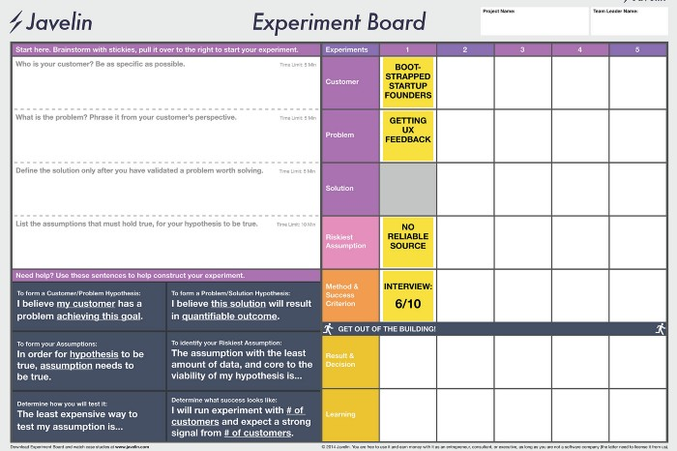
Unit 2: The Javelin Board
2.1 Purpose and Functioning
Right side:
Your second step!
It is the execute area, where the experiments will be carried out.
Left side:
You must start from here!
It is the brainstorming side, in which hypothesis
to test will be listed through post-its
Up to the bottom:
Get out of the building!
It is here that you will have the results, will take a decision and learn from the process itself!

Slide 21
Unit 2: The Javelin Board
2.2 Left Side: Brainstorming Area
In this area hypothesis are broken down in three types:
Customer: list customer segments;
Problem;
Solution.

Slide 22
Unit 2: The Javelin Board
2.2 Left Side: Brainstorming Area
!!! Take as much time as needed in understanding and validating customer and problem !!!
because:
Every customer has a problem;
Every problem has a solution;
Not every solution has a problem;
Not every problem has a customer.

Slide 23
Unit 2: The Javelin Board
2.2 Left Side: Brainstorming Area
You need to define the following:
Who is your customer? Be as much specific as possible
What is the problem? Phrase it from your customer’s perspective
Define the solution only after you have validated a problem worth solving.
!!! list the assumptions that have to be true
for the hypothesis to be true !!!

Slide 24
Unit 2: The Javelin Board
2.3 Right Side: Execute Area
In this area the experiments will be carried out.
Experiments are creating combining the hypothesis made in the left side.

Slide 25
Unit 2: The Javelin Board
2.3 Right Side: Execute Area
In this section we find:
Customer;
Problem;
Solution;
Riskiest Assumption.
!!! Your theses on each point above
need to be tested and verified,
choosing a method and establish in advance
the success criterion of the tests !!!
Method and Success Criterion will be noted in this area too.

Slide 26
Unit 2: The Javelin Board
2.3 Right Side: Execute Area
In Method and Success Criterion line, you must establish, and then monitor the
Key Performance Indicators
Through them, you will verify whether the initial hypotheses will be validated or not.
Exemples of KPI can be: number of visitors to your website, conversion rate achieved, average numerical value of orders, etc.

Slide 27
Unit 2: The Javelin Board
2.4 Underside: Get Out of the Building
In this last step you will collect and interpretate the data.
the two points in this last phase of the Javelin Board are:
Result and Decision
Learning

Slide 28
Unit 2: The Javelin Board
2.4 Underside: Get Out of the Building
Result and Decision
It is necessary to establish whether the hypothesis can be validate or not according to the established KPI
Learning
Here you propose the conclusions for each of the points.
!!! Always remember that
your final plan must respond to a real market need
to be successful !!!

Slide 29
Thank you for your attention!
With the support of the Erasmus+ programme of the European Union. This document and its contents reflects the views only of the authors, and the Commission cannot be held responsible for any use which may be made of the information contained therein.

